Slide 1
BOOLEAN POSTULATES CIT QUANTUM HACKATHON 2022
BOOBALARAGAVAN.P
VIJAY NARENDRAN.V
NAREN KARTHICK.T.P
ADITHYAN.A
LAKSHMAN KARTHICK.T

Slide 2
ABSTRACT
Our idea is to build set of reversible quantum circuits for the Boolean postulates with corresponding truth tables and different visualizations using Quantum theories.

Slide 3
BOOLEAN POSTULATES
A mathematician named, George Boole had developed this in 1854
This postulates deals with binary numbers & binary variables
Developed based on logic TRUE and logic FALSE and represented as digital input or output using logic symbols 0 and 1
It reduces the number of logic gates needed to perform a particular logic operation.

Slide 4
SOME OF THE POSTULATES
Disjunction
Conjunction
Identity law
Annulment law
Idempotent law
Inverse law
Double inverse law
Commutative law

Slide 5
WHAT WE DID
We have implemented for all postulates which possess two bits
We made users choice for selecting the postulates that users wants to see, and also for output and visualizations
The output for the respective postulate is viewed either using circuits, truth tables or visualizations.

Slide 6


TOOLS USED
Google Collaboratory:
Using colab, we executed the programs by setting up the corresponding backend objects(Simulators).
IBM Quantum Experience:
Using IBM quantum experience, we executed the programs by setting up the corresponding real quantum devices.

Slide 7
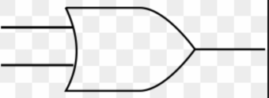


CLASSICAL GATES WE TOOK
Classical OR gate
Classical AND gate
Classical NOT gate

Slide 8
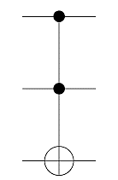


QUANTUM GATES WE USED
X - Not gate
CX - Controlled not gate
CCX - Double controlled not gate

Slide 9
OUTPUT GENERATED
Classical truth table
Quantum circuit
State vector output
Quantum visualizations

Slide 10
QUANTUM VISUALIZATIONS
Qsphere representation
Bloch sphere representation
Bloch vector representation
State city representation
State paulivec representation
State hinton representation

Slide 11
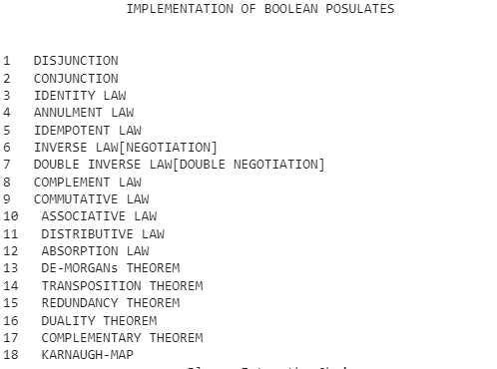
SAMPLE OUTPUT

Slide 12
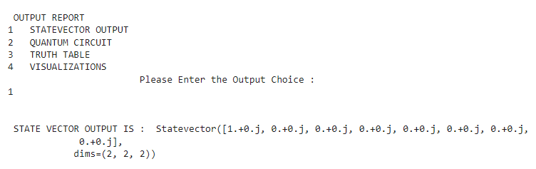
contd

Slide 13
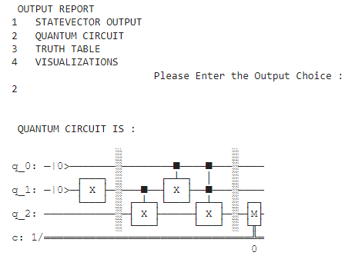
contd

Slide 14
CONCLUSION
Due to lack of qubits availability, we have implemented the reversible circuits for the postulates which possess two qubits or less than that.
In future, we like to enhance this project for many number of qubits by implementing the reversible circuits for other qubits also.

Slide 15
REFERENCES
Beginner’s Guide To Qiskit for quantum Computing (analyticsindiamag.com)
Learn Quantum Computation using Qiskit
Boolean algebra – Wikipedia
Boolean Algebraic Theorems – GeeksforGeeks
Lab 1. Quantum Circuits (qiskit.org)
Basic logic gates with truth tables & diagram | 2 & 3 input | Edumir-Physics (electronicsphysics.com)

Slide 16
Thank you

